Slide 1

World Bank Development Indicators An Exploratory Data Analysis and Visualization Report

Slide 2
Introduction and the Data
2017 World Bank Development Indicators
Rows correspond to a single country and columns are mainly development indicators of that country.
14 columns in total with a uniquely identifiable country name, 2 categorical variables for regions and income levels, and 11 numerical indicators.
Indicators include but not limit to GDP per capita, unemployment rate for both sex, life expectancy for both sex, and carbon dioxide emission per capita.
Analysis Focus
Identifying issues of data quality, such as missing data or outliers.
A brief exploration of the univariate and multivariate distribution of several variables.
Detecting any clustering behavior with the aid of dimension reduction techniques.

Slide 3
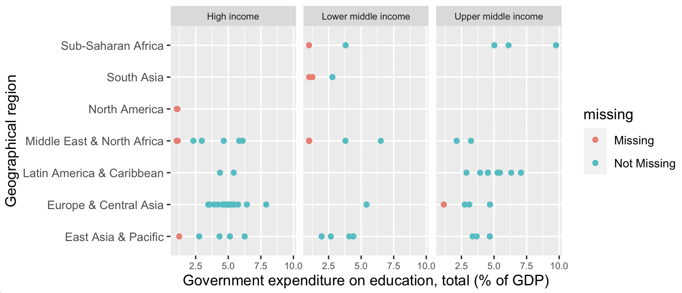
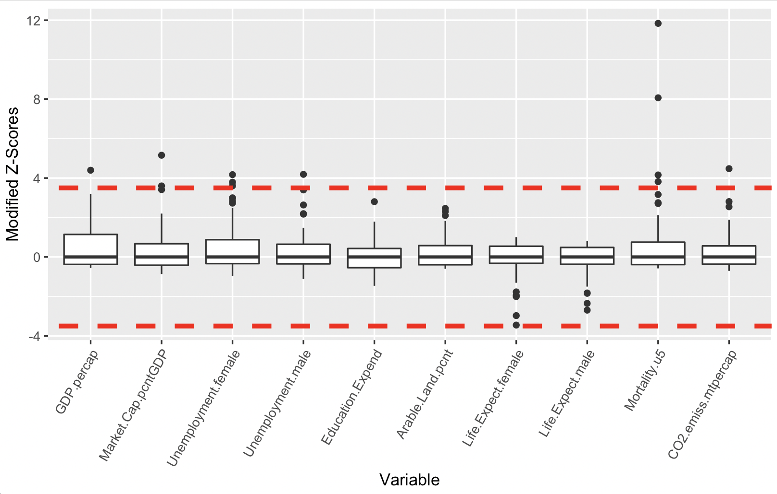
Data Quality
The education expense column is the only field that has missing values, and they are categorized as missing at random (MAR).
There are some outliers according to modified Z-scores criterion, especially the two points for mortality under five.
Using normal boxplots, we also discovered outliers for the percentage access to electricity.

Slide 4
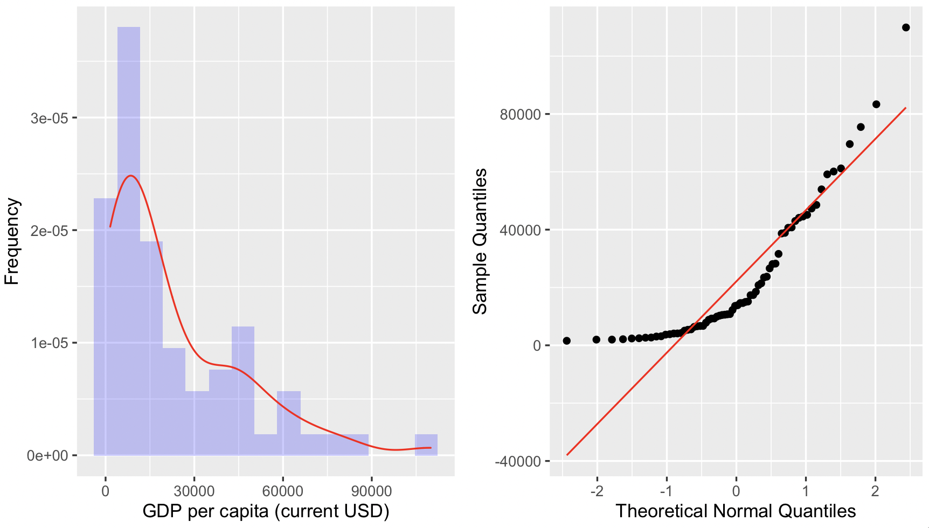
Univariate and Multivariate Analysis
Asymmetric right-skewed, non-normal empirical distribution for GDP per capita

Slide 5
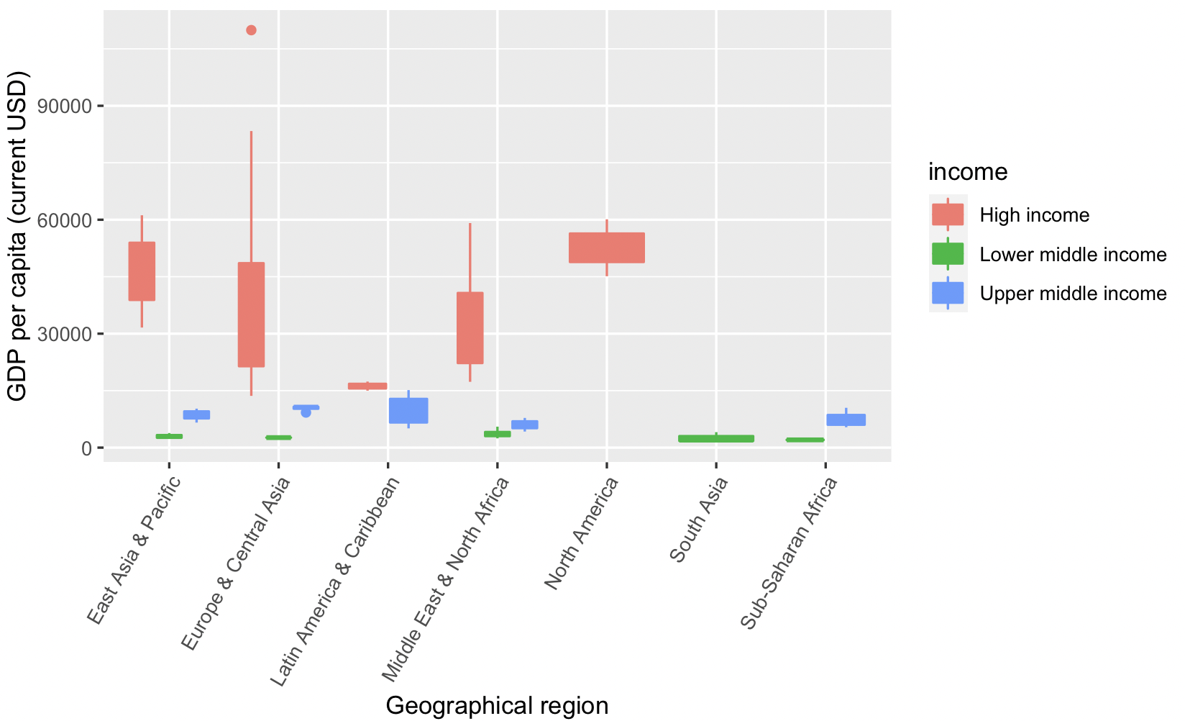
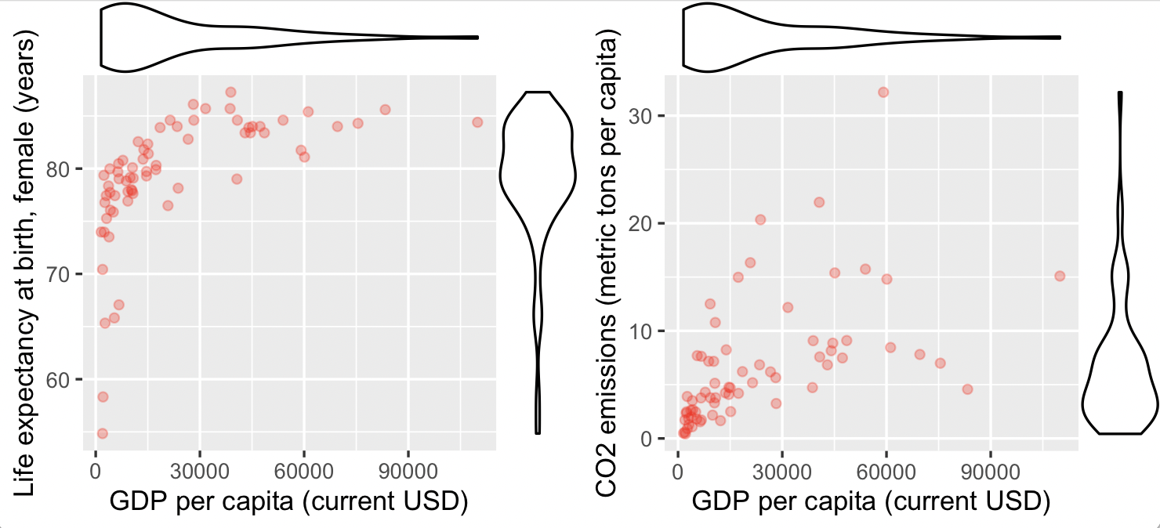
Univariate and Multivariate Analysis
Distributions of GDP per capita impacted significantly (visually) by income level and region
Positive trends detected in some of the variables against GDP per capita

Slide 6
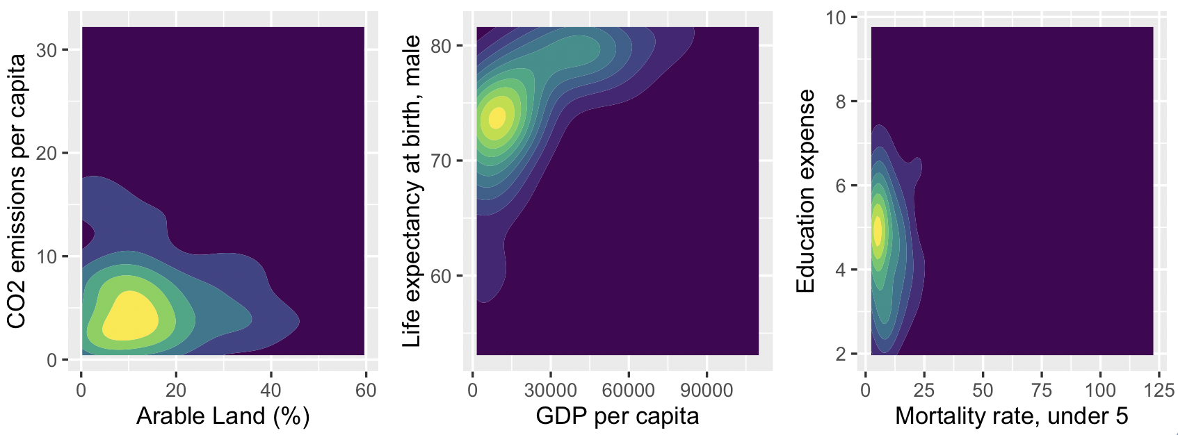
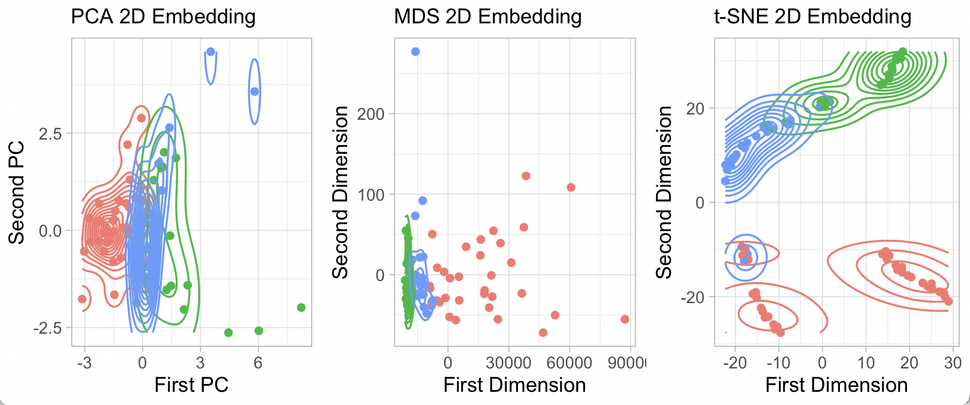
Dimension Reduction and Cluster Analysis
No distinctive clustering patterns observed in bivariate contour plots or generalized pairs plot
With the aid of dimension reduction techniques, clusters now become more separable.

